Slide 1



Patterns of Adapting to Health (PATH) as Drivers of Hospital Care Revenues: A Case Study
PATH Institute
www.pathinstitute.life

Slide 2

INTRODUCTION
Hospital marketing focuses on awareness building, brand promotion, and the promotion of service lines
The problem is diseases and health conditions linked to service line marketing don’t make health care decisions.
People do.

Slide 3

Adapting to Health and Disease
Patients with diagnosed disease must adapt
Adaptive actions are influenced & limited by health-related preferences, capabilities, habits
Following adaptive patterns, patients evaluate hospital brand promises, physician input, insurance, and make a final care choice

Slide 4
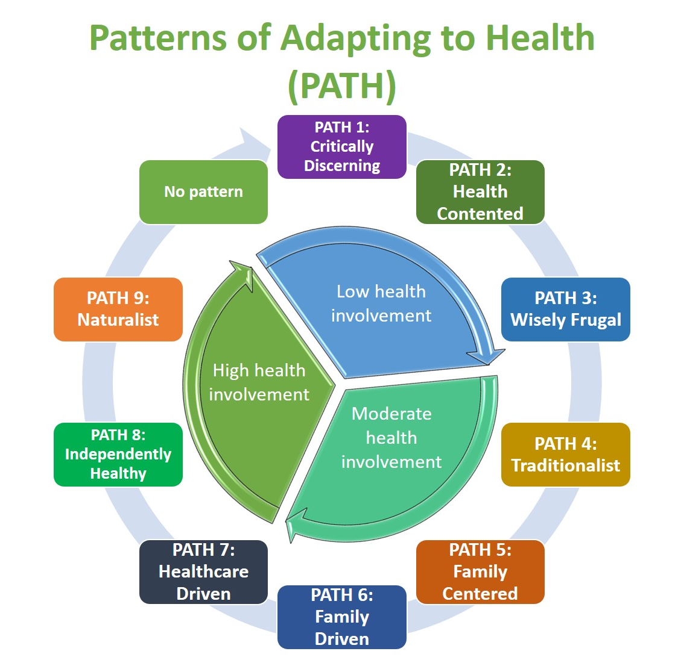
Patterns of Adapting to Health (PATH)
Quantitative description of the health-related adaptive patterns
Reliably captures diversity of how adults respond to and adapt to health and health care
Reliable-valid predictors of health, disease, demand for health care, and medical expenditures

Slide 5

Case Study Questions:
Does a patient’s PATH influence the need for hospital care as indicated by medical claims?
• Does a patient’s PATH influence the dollar value of per patient revenues that flow into hospitals?

Slide 6

APPROACH
Participant Data. Data from Blue Cross-Blue Shield of Florida in 2004. Facility expenditures from 2001, 2002, and 2003 across a sample of 8,295 adult health plan members
Measures. Adaptive Health Behavior Inventory (AHBI), member age, sex, and historical facility claims in U.S. dollars

Slide 7

APPROACH
Procedures
Facility medical claims across all three years were summed. Average facility claims expressed in 2017 dollars.
The AHBI data identified member’s dominant Pattern of Adapting to Health (PATH)
Analysis
Logistic regression evaluated odds of facility claims as a ratio of facility claims to no facility claims in relation to the PATH
PATH relationship to dollar value of facility claims were tested using the Kruskal-Wallis One-Way ANOVA on mean ranks

Slide 8

RESULTS
Descriptive Statistics
Total sample 55.5% female
Mean age = 49.2 years old
5,721 members (69%) had a least one facility claim (61.7% female), mean age = 50.3
Three-year average facility claims = $12,111 or $16,471 (2017 dollars)
PATH analysis identified dominant PATH for 90% of members
Significance Testing
Member’s PATH predicted higher or lower odds of a facility claim (greater than 99.9% confidence).
Mean facility claims differences across member’s PATH highly significant (greater than 99.9% confidence).
α = .01

Slide 9
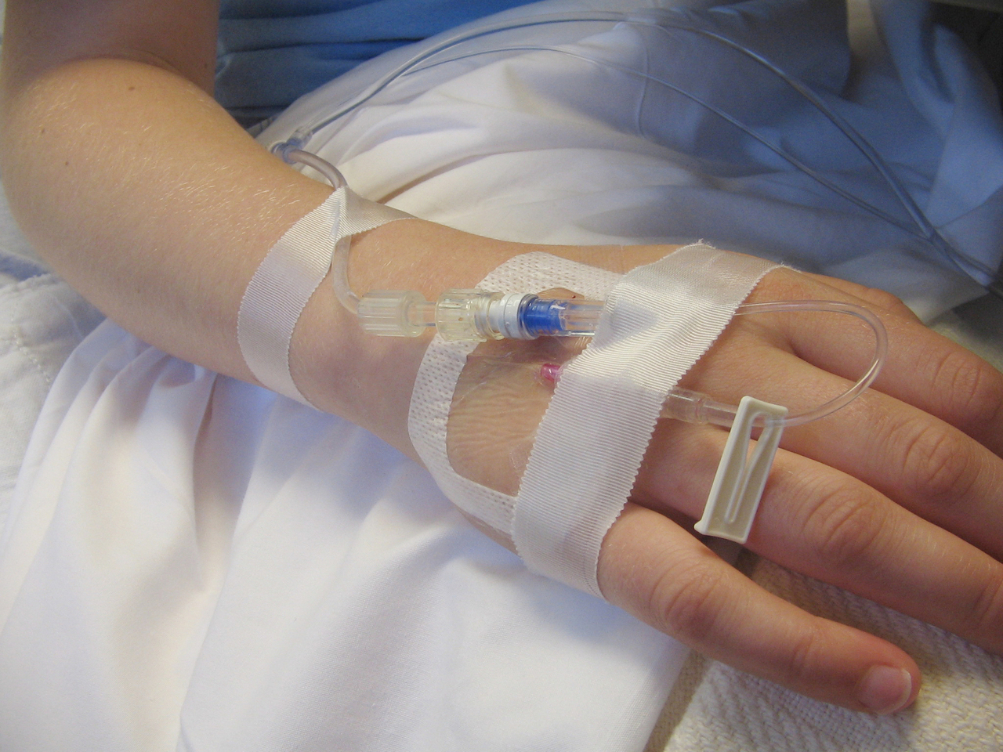
RESULTS
Generating Facility Claims
Patients from four PATH had greater odds of one or more facility claims:
  Critically Discerning PATH1, 159% higher rate
  Family Centered PATH 5, 148% higher rate
  Family Driven PATH 6, 152% higher rate
  Healthcare Driven PATH 7, 137% higher rate
Only patients with “no pattern” had 14% lower odds of a facility claim

Slide 10

RESULTS
The Value of Facility Claims
Traditionalist PATH 4 generated $21,989 in facility claims per patient ($5,518 per patient above average in 2017 dollars)
Healthcare Driven PATH 7 generated $21,206 per patient ($4,735 per patient above average in 2017 dollars).
Patients dominated by the remaining PATH generated facility claims below the total sample average.

Slide 11
DISCUSSION
PATH and Demand for Hospital Care
A patient’s PATH influenced the odds of obtaining hospital care based on objective medical claims
Patients from four PATH had increased odds of receiving hospital care
A patient’s PATH
influences the odds of obtaining hospital care

Slide 12
DISCUSSION
The PATH and Value of Facility Claims
A patient’s PATH influenced the dollar value of hospital claims generated per patient
Patient’s dominated two PATH generated higher facility claims over 3 years
Traditionalist PATH exceeded the average claim by $5,518 per patient (2017 dollars)
Healthcare Driven exceeded the average claim by $4,735 per patient (2017 dollars)
A patient’s PATH
influences the per
patient revenues that flow into
hospitals

Slide 13
DISCUSSION
Accounting for Total Facility Claims Dollars
Patients from Healthcare Driven PATH 7 account for largest share of total facility claims at over $327 thousand (28%) of the total facility claims value per 100,000.

Slide 14

IMPLICATIONS
A patient’s
dominant PATH
influences both their demand for
hospital care and the value of that care to hospitals in terms of revenue generation as
expressed in actual claims dollars.
Case study supports relevance of PATH to hospitals and hospital marketers
The Healthcare Driven PATH 7 offers the most value to hospitals and hospital marketers
The Patterns of Adapting to Health (PATH) give hospital marketers insight into the link between patient health-related adaptive patterns and demand for hospital services
The PATH provides hospital marketers with information to tailor brand messaging and service line advertising to optimally appeal to the high demand consumers who make the actual health care decision

Slide 15

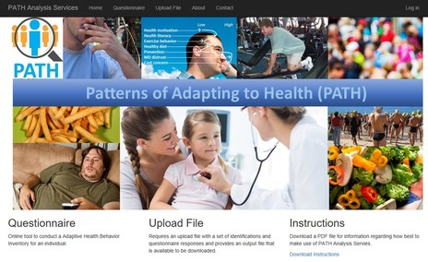
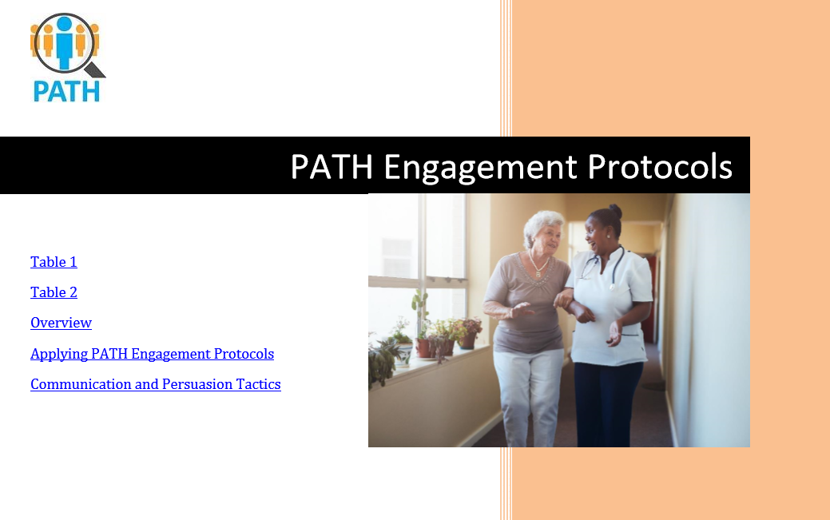
Patterns of Adapting to Health (PATH)
Products & Services
The Adaptive Health Behavior Inventory (AHBI) - the only assessment that can identify the Patterns of Adapting to Health (PATH)
PATH Analysis Services - gives clients the power to identify the PATH mix within a patient, member, or community population, or diagnose an individual’s dominant PATH through analysis of AHBI response data 24/7
PATH Engagement Protocols - applied to messaging and media make it easy to tailor marketing communications and advertising to appeal to adults based on their PATH.
fred@pathinstitute.life
909-695-0090

